Slide 1


MongoDB Datatypes
By Deepak Manohar

Slide 2
Index
Data Types
1.1. what is Data Types.
1.2. Integer
1.3. Boolean
1.4. Double
1.5. String
1.6. Arrays
1.7. Object
1.8. Date
1.9. Null

Slide 3
1.1 Data Types
Data types is essential component of a language or script that is used to define a type of data being used in framing an database.
MongoDB stores data in BSON format.
Types of Data types and its implementation on next slide.

Slide 4
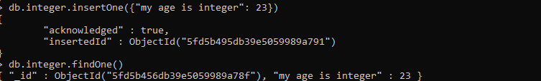
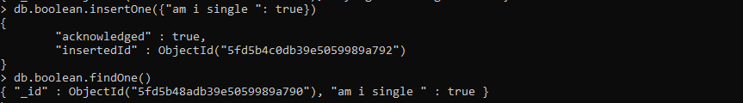
1.2.Integer 1.3.Boolean

Slide 5
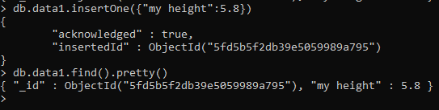
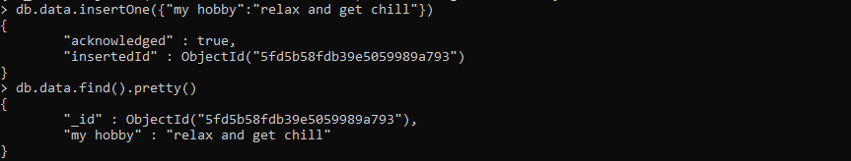
1.4. Double 1.5. String

Slide 6
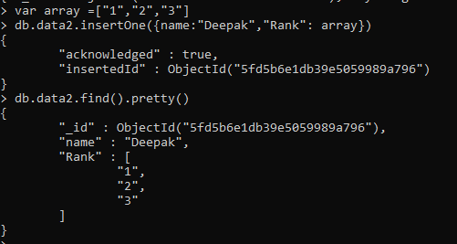
1.6. Arrays

Slide 7
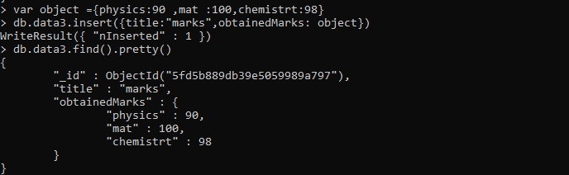
1.7. Object

Slide 8
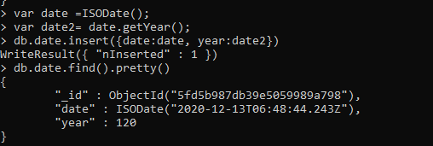
1.8. Date

Slide 9
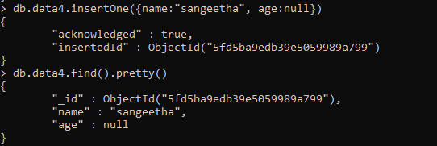
1.9. Null
Binary data:
Binary data is implemented for storing binary data.
Object ID:
Object ID is implemented for storing the ID of the document.

